Slide 1

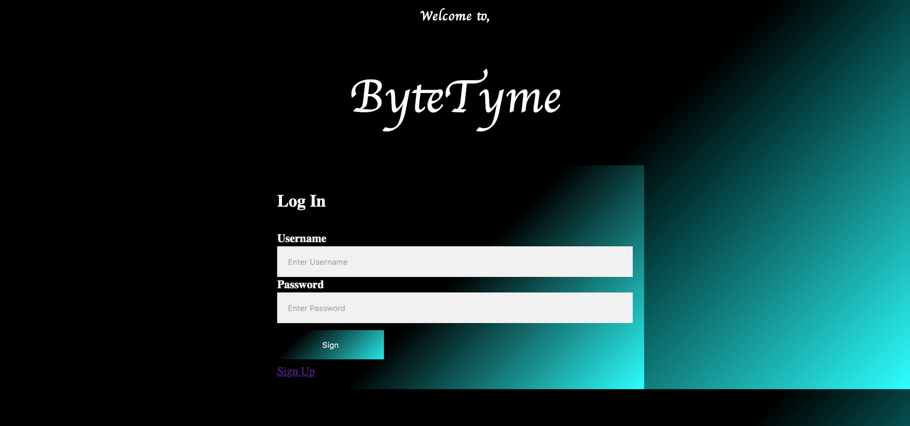
WebNerds
Game to test user knowledge on CS.

Slide 2
WebNerds
Team Leader: Acharya, Tek
Duties: Coordinate meetings, breakdown work among team member, created signup and login php pages to support user validation and sessions. Tester
Team Member: Ali, Mohammad
Duties: Build php page for quiz and leader board to support collecting user score and managing leaderboard . Tested and Debugged php codes.
Team Member: Jean, Ilka
Duties: Gather content for web page, create quiz questions, build html and css layout and design, create powerpoint, signup php page. Testing and debugging code for login php page. Tester
Project: ByteTyme

Slide 3
Outline
The Problem:
Solution:
Demo
Testing(Issues we faced)

Slide 4
The Problem
“It would have been easier if I could test my general knowledge of Computer Science, but there’s no way I can do that.”

Slide 5
Solution
We have created a interactive web page that helps you test and enhance your knowledge of Computer Science . You can even keep track of your progress. uter Science. You can keep track of your progress.

Slide 6

Scrum Framework
Teamwork
Ilka Jean
Designer, HTML/CSS, Debugger
Mohammad Ali
Board Update
Tek Acharya
Php Session
We divided our project into three parts and assign a member to work on it independently and collaborated later when we had issues.

Slide 7
PROJECT DEMO

Slide 8
Issues We Faced
Sessions
Ranking the users

